Slide 1
HUMAN BONDS
MY BIG BROTHER

Slide 2
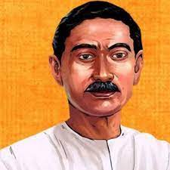
AUTHOR
“To be successful in life what you need is education, not literacy and degrees.” – Munshi Premchand.

Slide 3
AUTHOR
Munshi Premchand was a famous Indian writer.
The title Munshi was given to him by his admirers in the honor of his quality and effective writing.
He was a novel writer, story writer, dramatist, and also known as “Upanyas Samrat”.
His works include more than a dozen novels, 250 short stories, several essays, and translations of famous literary works in Urdu and Hindi.

Slide 4
SUMMARY
The elder brother is a hardworking fellow who studies hard. He wishes to build a strong foundation through his education. On the other hand, the younger one prefers playing all day long and doesn't give much time to his studies. Thus, the elder brother always scolds his little one to be more sincere.

Slide 5
SYNONYMS
Proclaimed- declared
Tongue- lashing- a loud scolding
Demoralize- to make somebody loose confidence
Miscellaneous- various
Meddle- to try to change
Pounced – Leap, attack
Flunked- fail
Rote- learning a fact by repeating it
Reverence- a feeling of great respect

Slide 6
Video
https://youtu.be/n4AmZ64ZaoA

Slide 7
THANK YOU

Slide 8
REFERENCES & THANKING SLIDE

